Slide 1
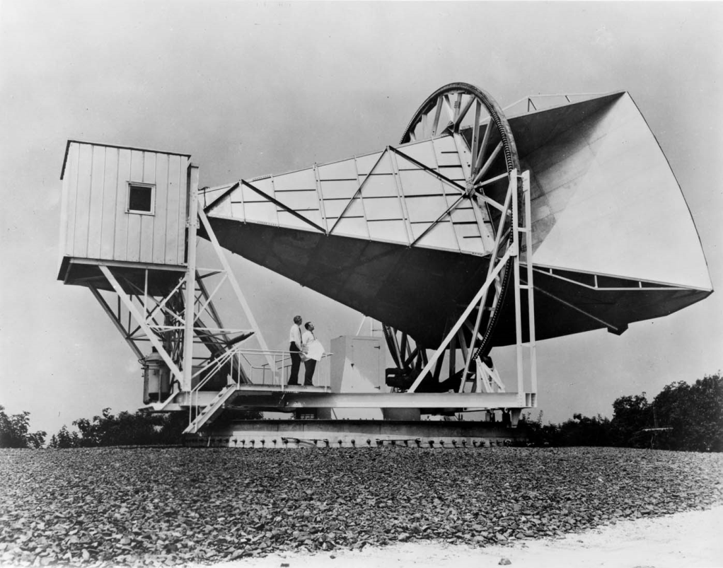
Evidence to Support the Theory
2.Cosmic Background Radiation
In 1965 Arno Penzias and Robert Wilson were using a new microwave antenna with the intention of using it for telecommunication.
What they picked up was microwave radiation from the sky in all directions, not just from stars
But what did that mean?

Slide 2
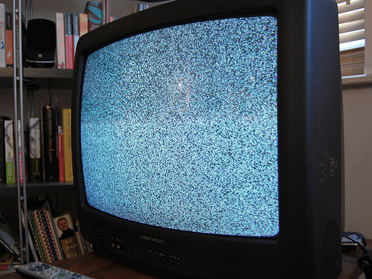
Evidence to Support the Theory
Cosmic Background Radiation
Penzias and Wilson unintentionally discovered cosmic background radiation.
It is believed that this is leftover radiation from the initial big bang.
Penzias and Wilson later
won a Nobel Prize for their
serendipitous find.

Slide 3
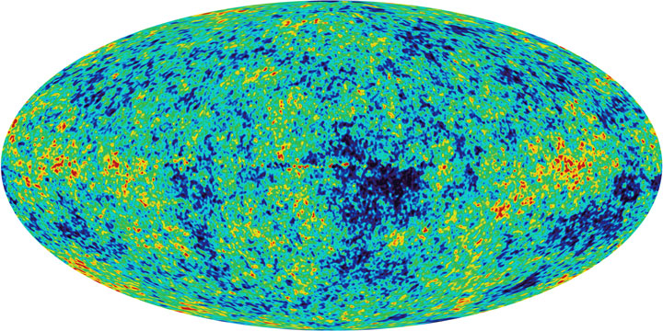
Testing the Big Bang model
Prediction: If the universe was denser, hotter, in past, we should see
evidence of left-over heat from early universe.
Observation: Left-over heat from the early universe. (Penzias and Wilson, 1965)
Notes:
Big Idea: evidence for the Big Bang model - leftover heat from the early universe
If you run the expansion of the universe backwards, there comes a time when the universe becomes very hot, dense and opaque - like living inside the Sun. The light from this time - 13.7 billion years ago, still bathes the cosmos. Originally at 3000K, it has now cooled to 3K, and can be detected by sophisticated radio telescopes such as WMAP (Wilkinson Microwave Anisotropy Probe).
Like Hubble’s observation of galaxies moving apart from each other, the discovery of this leftover heat is another line of evidence that supports the Big Bang model.

Slide 4
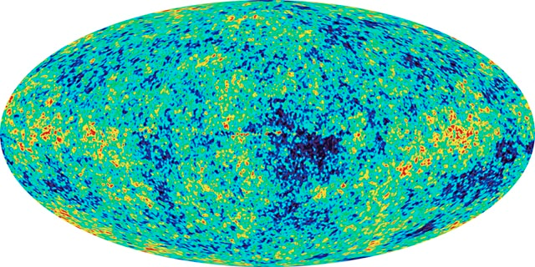
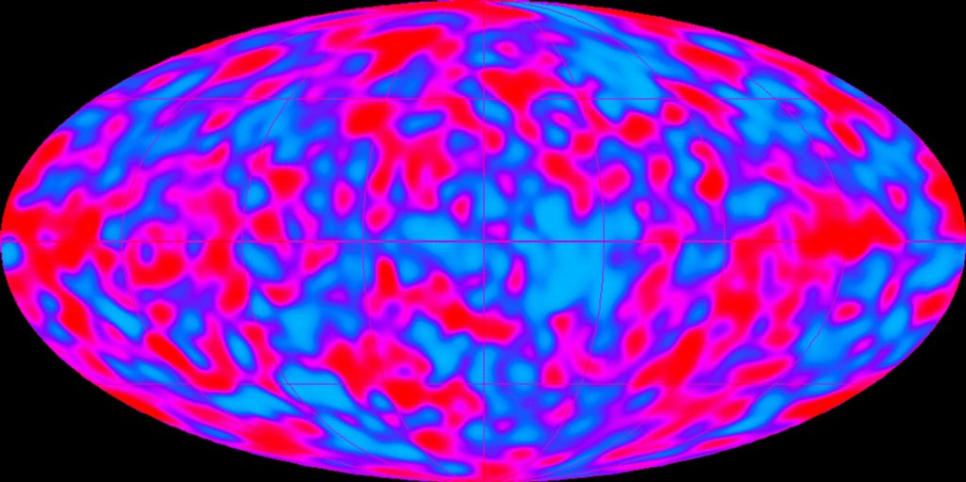
Evidence to Support the Theory
3. Radiation Mapping
Cosmic Background Explorer (COBE) satellite created detailed maps of the background radiation from distant parts of the universe in 1992.
Wilkinson Microwave Anisotropy Probe (WMAP) in 2006 provided even more precise measurements of the radiation.

Slide 5
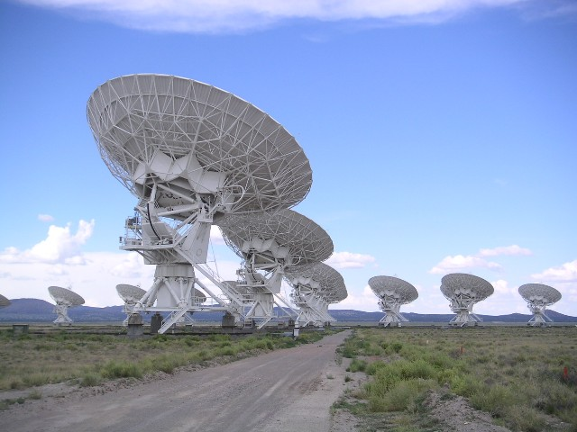
Notes:
Very Large Array radio telescopes, Socorro, New Mexico, USA
(Hajor, 2004)

Slide 6
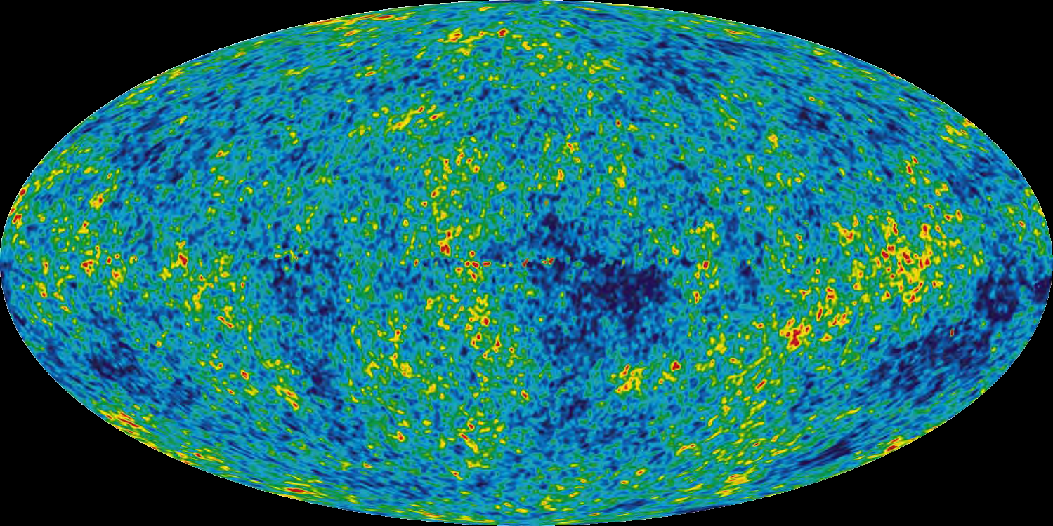
Notes:
Cosmic microwave background radiation (CMBR)
(NASA)

Slide 7
Evidence to Support the Theory
Radiation Mapping
analysis of temperature differences and microwave polarization from these maps provided the point of inflation
Inflation is the idea that the universe expanded many trillion times its size faster than a snap of the fingers at the outset of the Big Bang
This breakthrough that enabled scientists to analyze what happened less than a trillionth of a trillionth of a second after the Big Bang.

Slide 8
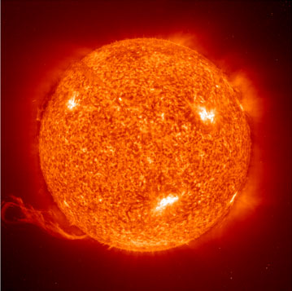
Testing the Big Bang model
Prediction: A hot, dense expanding universe, should be
predominantly hydrogen, helium.
Observation: Universe is ~75% hydrogen, ~25% helium by mass
The Sun: 74.5% H, 24% He by mass
Cecilia Payne
Notes:
Big Idea: evidence for the Big Bang model - composition of the universe.
The simplest of atoms, hydrogen, gets cooked into heavier elements at a high enough temperature and density (such as the cores of stars). In the early hot and expanding universe, this fusion process only has time to cook hydrogen to helium (plus a little lithium) before the expansion and cooling shuts down the nuclear furnace. All elements above helium in the periodic table are created in the life cycles of stars. The theory is 12:1 ratio hydrogen to helium by number, or 75% 25% by mass, from the Big Bang. Exactly what is observed. The chemical composition of stars (and the fact that they were predominantly hydrogen) was determined by Cecilia Payne (1925)
The composition of objects in the universe is one of several lines of evidence that supports the Big Bang model.
(Note: In 1925 Cecilia was the first person to receive a Ph.D. in astronomy from either Radcliffe or Harvard University, and the first person to receive a doctorate using work done at the Harvard Observatory. In 1934 she married Sergei Gaposchkin and hyphenated her name.)

Slide 9
Evidence to Support the Theory
4.Proportion of Matter in Stars
Simplest atoms, hydrogen, gets cooked into heavier elements at a high enough temperature and density (such as the cores of stars).
In the early hot and expanding universe only enough time to fuse hydrogen to helium before expansion and cooling shuts it down.

Slide 10
Isotopes of
Hydrogen

Slide 11
Evidence to Support the Theory
Proportion of Matter in Stars
The theory is 12:1 ratio hydrogen to helium by number, or 75% 25% by mass, from the Big Bang.
Most matter detected from the universe fits this composition supporting the Big Bang Theory.

Slide 12
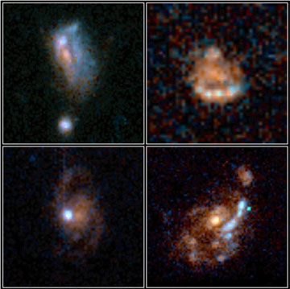
Testing the Big Bang model
Prediction: An expanding universe is evolving over time. If we look at the early universe, it should appear different.
Observation: Distant galaxies less evolved, physically and chemically.
Notes:
Big Idea: evidence for the Big Bang model - early galaxies look different.
Looking out in space is looking back in time. Distant galaxies therefore appear as they did in a less evolved universe. These early galaxies are more disturbed because of collisions with other galaxies, smaller and contain fewer heavy elements (“heavy element” is an astronomer’s expression for all elements other than hydrogen and helium).
Note to the presenter, if asked about the statement “looking out in space is looking back in time”: light takes time to travel through space. When light leaves an object it carries information about what the object looks like when the light left it. The further away an object it, the longer it takes to reach our eyes and telescopes. Therefore light that has been traveling from very far away carries information about what that objects looked like very long ago.

Slide 13
Evidence to Support the Theory
5. Observation of Distant Galaxies and Stars
An expanding universe is evolving over time. If we look at
the early universe, it should appear different.
Distant galaxies therefore appear as they did in a less evolved universe.
These early galaxies are more disturbed because of collisions with other galaxies, smaller and contain fewer heavy elements

Slide 14
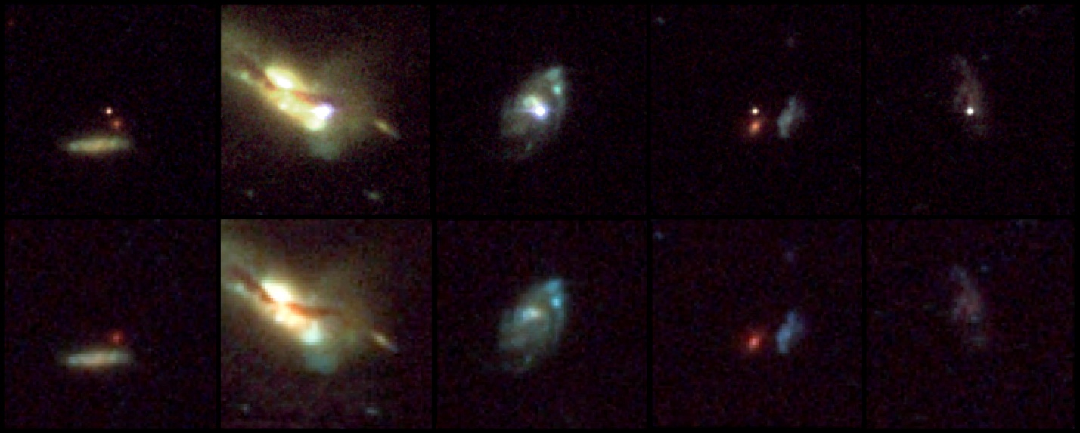
Notes:
Host galaxies of distant supernovae
(NASA, ESA, and A Reiss (STScl))

Slide 15
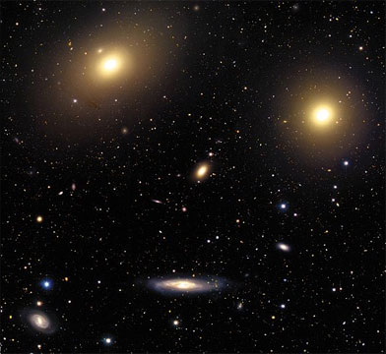
Testing the Big Bang model
Prediction: The universe is expanding
Observation: Galaxies are moving apart from each other (1929)
Notes:
Big Idea: evidence for an expanding universe
Further study of the motions of the galaxies by Hubble revealed that they were racing away from us and each other: proof of an expanding universe (1929).
Many people believe that the Big Bang is “just a theory” with no evidence to support it. In science, the word “theory” means an idea that is well-established and supported by scientific evidence. Hubble’s observations of galaxies moving apart from each other is one of SEVERAL lines of evidence that supports the Big Bang model.

Slide 16
Evidence to Support the Theory
6. Expanding Dynamic Universe
According to Einstein, space-time of the universe is expanding
and because of it the galaxies are drifting apart.

Slide 18
Evidence to Support the Theory
Expanding Dynamic Universe-
Raisin Bread Analogy

Slide 19
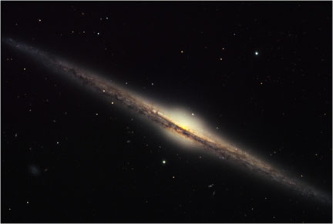
Testing the Big Bang model
Observation: 90% of matter is an unknown form: Dark Matter.
Refine: A new and unknown form of matter exists. But its gravity
works the same way, and its presence is needed to explain how
the universe looks.
Vera Rubin
Notes:
Big Idea: dark matter and how it fits into the Big Bang model
90% of matter in and between galaxies is of an unknown form that does not emit or absorb light. It can be detected through its gravity by the way it affects objects we can see. Dark matter was first detected between galaxies by Fritz Zwicky (1933) and in galaxies by Vera Rubin (1978). Without dark matter, normal matter would have been unable to clump and form stars and galaxies - and us.
If you wish to supplement this slide with a scientific animation, visit http://chandra.harvard.edu/resources/animations/galaxy_clusters.html and click on “Optical/X-ray Dissolve of MACSJ1423”
This animation shows views of the galaxy cluster MACSJ1423, using optical and X-ray telescopes. The optical image, a 3-color composite from the Subaru prime focus camera, shows white and blue galaxies centered around a large elliptical galaxy. The Chandra X-ray image shows hot gas displayed in red. The mass of the hot gas is about 6 times greater than the mass of all the billions of stars in all of the galaxies in the cluster. This galaxy cluster has a redshift of 0.54, at a distance corresponding to a light travel time of 5.4 billion years. [Run Time: 0:06] Credit: Optical: NAOJ/Subaru/H. Ebeling; X-ray: NASA/CXC/IoA/S.Allen et al.

